Slide 1
Greek and Hellenistic

Slide 2
Bellringer
Can you name an art piece from this time period?

Slide 3
Greek and Hellenistic (850 b.c-31 b.c.)

Slide 4
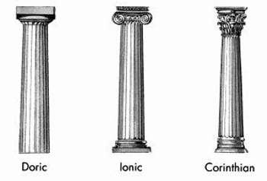
This time period was all about idealism, getting things to look perfect, and hitting hard architectural standards.

Slide 5
Parthenon
Temple of Athena
Doric order columns

Slide 6
Myron’s Diskobolos
Myron was a famous artist from this time period. This sculpture has been linked to the “Hercules” character.
Created sculptures based on mythology such as minotaurs and half-animal, half-human figures

Slide 7
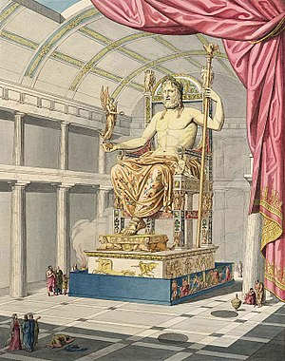
Phidias
Statue of Zeus at Olympia in the Temple of Zeus

Slide 8
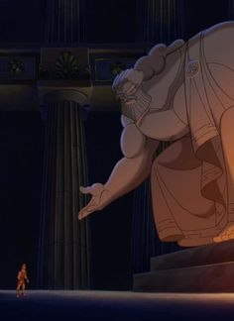

Slide 9
Praxiteles
Famous Sculptor of this time period
Some think that there may have been 2 sculptors with this name

